Slide 1


Library CARES
FY2025 Kick Off Meeting
October 15, 2024

Slide 2
Objectives:
Welcome!
Who is AgeOptions and what do we do?
Grant Purpose and Work Plan
Four Requirements:
Display of Aging Network Materials
Increase Access to Technology
Address Social Isolation
Establish Connections to the Aging Network and to AgeOptions
Administrative Details:
Dates, Reporting Form, Webpage, Quarterly Meetings, Welcome Packet
Mission and Definitions
What is the Aging Network?
Q&A, Requests, Adjourn
Notes:
Our agenda for today includes the following:

Slide 3



FY25 Welcome to You!
Acorn PL
Alsip-Merrionette Park PLD
Berkeley PL
Berwyn PL
Blue Island PL
Calumet City PL
Calumet Park PL
Chicago Heights PL
Chicago Ridge PL
Des Plaines PL
Dolton PL
Eisenhower PL
Evanston PL
Evergreen Park PL
Flossmoor PL
Forest Park PL
Glenwood-Lynwood PLD
Grande Prairie PL
Hodgkins PL
Hometown PL
Homewood PL
Lansing PL
LSF Brookfield PL
Markham PL
Maywood PLD
Morton Grove PL
Niles-Maine PLD
North Riverside PLD
Northlake PLD
Oak Lawn PL
Park Forest PL
Phoenix PL
Prairie Trails PLD
Richton Park PLD
Riverdale PLD
Schiller Park PL
South Holland PL
Steger – South Chicago Heights PL
Stickney-Forest View PLD
Summit PLD
Thornton PL
Tinley Park PL
William Leonard PLD
Worth PLD
Notes:
FY25 LIBRARY CARES PROGRAM

Slide 4

Who is AgeOptions?
Notes:
I THOUGHT THIS WOULD BE A GOOD TIME FOR A PRIMER ON AGEOPTIONS AND THE AGING NETWORK. THIS NEXT SECTION IS SOMETHING I WOULD LOVED TO HAVE WHEN I WAS STARTING OUT ON THE LIBRARY SIDE OF THE GRANT MANY YEARS AGO.

Slide 5

We are responsible for planning services to meet the needs of older adults (60+)
We developed the aging network in suburban Cook County.
We work with local agencies that are the gatekeepers to older adult services and a source of high-quality information
Who is AgeOptions?

Slide 6
AgeOptions Functions:
Grant $ to local agencies who provide direct services
Provide oversight and technical assistance to grantees
Plan for future needs and services for older adults
Provide information and assistance
Conduct special projects
Who is AgeOptions?
Notes:
AGEOPTIONS PROVIDES FUNDING FOR OLDER ADULT SERVICES IN SUBURBAN COOK COUNTY.

Slide 7
Our Mission:
AgeOptions innovates, partners, and advocates to improve systems and services in order to strengthen communities so people thrive as they age.
Who is AgeOptions?

Slide 8
The Aging Services Network
House
President
Senate
Department of Health and Human Services
Administration for Community Living
Administration on Aging
Governors/State Legislators
State Units on Aging
State Advisory Councils
Area Agencies on Aging
Access Services
Local Service Providers
Senior Centers
Community Services
Institutional Services
In-home Services
Voluntary Organizations
Public Libraries
Legal Assistance
Nutrition Services
Notes:
JASON: Plan, Fund, Coordinate And Advocate For Services For Older Adult, People With Disabilities And The People Who Care For Them
SERVICES DELIVERED THROUGH A NETWORK OF 40+ SERVICE PROVIDERS (EXPERTS IN THEIR LOCAL SERVICE AREA AND/OR THEIR PROGRAMS)

Slide 9
AgeOptions is the Area Agency on Aging for Suburban Cook County
Plan, fund, coordinate and advocate for services for older adult, people with disabilities and the people who care for them
Most services are delivered through a network of over 40 service providers
  Experts in their local service area and/or their programs
Provide programmatic Technical Assistance and monitoring
Deliver programs directly to fill gaps and do our best to demonstrate innovation in service delivery
Notes:
PLAN, FUND, COORDINATE AND ADVOCATE FOR SERVICES FOR OLDER ADULT, MOST SERVICES ARE DELIVERED THROUGH A NETWORK OF OVER 40 SERVICE PROVIDERS -- EXPERTS IN THEIR LOCAL SERVICE AREA AND/OR THEIR PROGRAMS

Slide 10

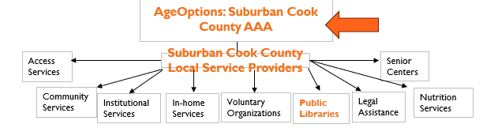

FY25 Library CARES Program!!
You are part of the Aging Services Network.
We’re happy to have you on our team!!!!!
You are here!
Notes:
SPENDING MORE TIME ABOUT THIS NETWORK LATER… AGEOPTIONS AND ALL OUR FUNDED PARTNERS – INCLUDES YOU! YOU are part of the network! You don’t need to be the expert – get in touch with these partners. YOU ARE NOT ALONE!!!!! (Don’t worry – we’ve got your back!)

Slide 11

FY25 Library CARES Program!!
Notes:
FY25 LIBRARY CARES PROGRAM

Slide 12

FY25 Library CARES Program Mission
The mission of the Library Program is to establish connections to the Aging Network service agencies in your community, increase access to technology for adults 60+, and to address social isolation in communities by providing resources through targeted programming to build community engagement.
Notes:
FY25 LIBRARY CARES PROGRAM

Slide 13


Definitions to Know
Notes:
These are listed in your Work Plan

Slide 14



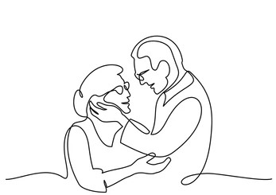
Older Adult
Older Adult – For AgeOptions funding, older adult means 60 or older.
Definitions to remember
Notes:
We understand that library programs are typically open to all community members. For the programs or services, you provide under this funding, we ask that you target and prioritize older adults.

Slide 15


Caregiver
Caregiver – AgeOptions defines Caregiver as a person caring for an older adult or person of any age with Alzheimer’s disease or a related disorder. This includes spouses, children, other relatives, unmarried partners, neighbors, etc.
Definitions to remember
Notes:
In Work Plan

Slide 16


Priority Groups
Priority Groups – AgeOptions funded programs are targeted and open to all adults 60 and older. When you see “priority groups, we mean:”
Low income
Persons of color
Limited English speaking
LGBTQ+
Homebound older adults
Definitions to remember
Notes:
You serve everyone – we do too! Acknowledgement of priority groups and reaching out to them through programs.
In Work Plan

Slide 17

FY25 Library CARES Grant Requirements
Notes:
Let’s move on to talk about the grant requirements – nothing scary or hard – many of you are already doing these requirements.

Slide 18


Core Requirements
Display of Aging Network Materials
Establish connections to the Aging Network
Technology Education
Address social isolation
FY25 Library CARES Grant Requirements
Notes:
These are all in your Work Plan

Slide 19
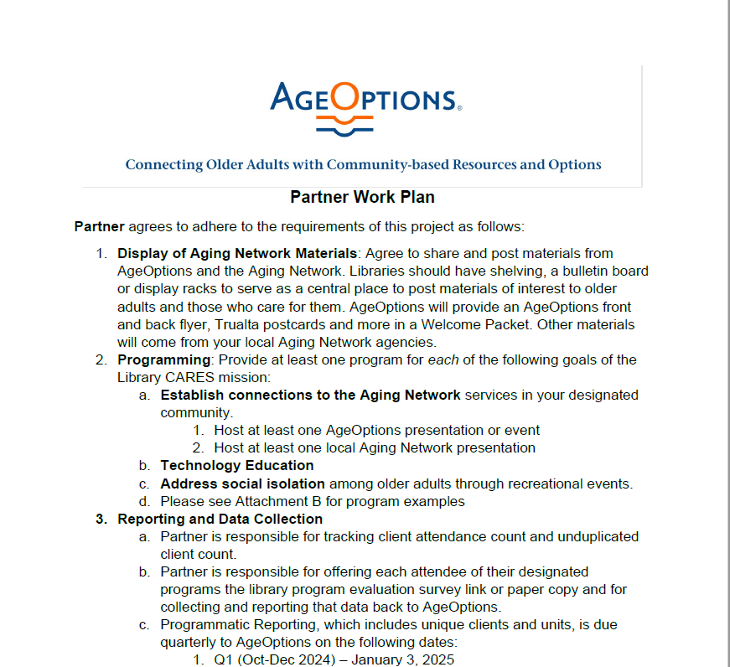
FY25 Work Plan
Notes:
WORK PLAN This will help you determine how best to fill the grant requirements
Will be on the Library Partner Web Page
It is also in your stipend agreement PAGES 4-7

Slide 20
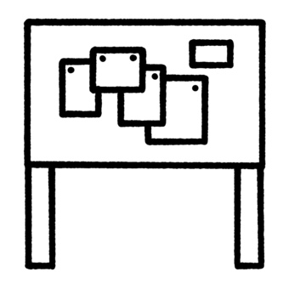



Requirements
Display of Aging Network Materials
FY25 Library CARES Grant Requirements
Notes:
Shelving, a bulletin board or display racks to serve as a central place to post materials of interest to older adults and those who care for them. ***WE STRONGLY ENCOURAGE YOU TO INCLUDE materials from your area’s ADRN or CRC. A great way to introduce your patrons (and staff!) to the Aging Services network.

Slide 21
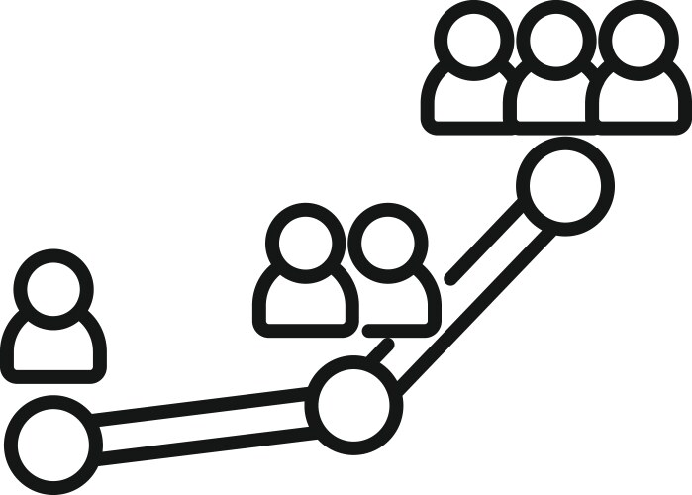

Requirements
Establish connections to the Aging Network
  Host at least one local Aging Network presentation
  Host at least one AgeOptions presentation or event
  Advertise and promote all Aging Network hosted programs
FY25 Library CARES Grant Requirements
Notes:
Invite your local ADRN or CRC to come to the library – discuss services, provide a presentation, or share materials, outpost. We will connect you with your area’s Aging Network partners. Examples of AgeOptions presentations are in the Work Plan – or check with us if you don’t see what you are looking for. ASSISTANCE IN PROMOTING THESE PROGRAMS at the minimum

Slide 22


AgeOptions Presentations and Events:
Take Charge of your Health*
Take Charge of your Diabetes*
Take Charge of your Pain*
Cancer Thriving and Surviving*
Fit & Strong*
Benefit Enrollment Center (BEC) Presentation and/or Enrollment Event
Dementia Friendly
Illinois Senior Medicare Patrol (SMP) BINGO*
(*available in Spanish and English)
Services provided through AgeOptions
Notes:
Here are some options for your AgeOptions hosted presentation – we will be sharing a detailed list with explanations SOON
THERE WILL BE A SURVEY TO RANK. YOU WILL BE CONTACTED BY THE PROGRAM’s coordinator to find out more if the program is something that fits your library’s needs
PLUG AND PLAY PROGRAMMING

Slide 23


Requirements
Technology Education (ie. Tech Literacy)
FY25 Library CARES Grant Requirements
Notes:
TL: This includes a variety of possibilities from purchasing computers and hot spots, to offering educational and informative tech sessions
REFER TO WORK PLAN

Slide 24


Requirements
Address social isolation through recreational events
FY25 Library CARES Grant Requirements
Notes:
ASI: This includes a variety of possibilities from exercise classes to historical portrayals and other presentations
REFER TO WORK PLAN

Slide 25


Aging Network
Notes:
Moving on from Requirements, let’s switch to SERVICES AVAILABLE

Slide 26

The Aging Network
Notes:
DO YOU REMEMBER THIS SLIDE FROM EARLIER IN THE PRESENTATION?
Aging Network: includes AgeOptions and the social service agencies in suburban Cook County. The Aging Network includes your local ADRN (Aging and Disability Resource Network) agency, Caregiver Resource Center (CRC), congregate meal site and more. I’ll show you how to search for these services in a few slides. You can search for your local ADRN and CRC by address at services.ageoptions.org
YOU ARE PART OF THE NETWORK! YOU DON’T NEED TO BE THE EXPERT – GET IN TOUCH WITH THESE PARTNERS

Slide 27

What is the Aging & Disability Resource Network?
ADRNs:
Entry point of access for older adult services
Provide services by township in suburban Cook County
Provide services including general requests, referrals, and resources to Older Adults
AgeOptions funds ADRNs to provide services for older adults
Notes:
ADRNs are Your ONE STOP SHOP – ADRNs are where you start!
*AgeOptions funds community organizations designated as Aging and Disability Resource Networks (ADRNs)
*ADRNs serve as first point of access for older adult services. Each ADRN serves a particular geographic area.
To find a local ADRN
https://services.ageoptions.org/

Slide 28
What is a Caregiver Resource Center?
CRCs:
The place in the Aging Network for caregivers to find support
Provide help by sharing information and connecting them to specific services and tools to support the caregiving journey.
Provide services to enable families to cope with the stress of their caregiving roles
AgeOptions funds CRCs to provide services for caregivers
Notes:
The FIRST STOP in the Aging Network for caregiver assistance (for themselves or their family member)
CAREGIVER SUPPORT OFFERS HELP TO THOSE CARING FOR A LOVED ONE, INCLUDING COUNSELING, EDUCATION, IN-HOME AND OUT-OF-HOME RESPITE CARE, SUPPORT GROUPS AND OTHER SERVICES

Slide 29


Meal Programs
Nutritional Meals are available at congregate dining sites or can be delivered to your home.
AgeOptions provides funds to congregate meal sites to provide food and socialization
Notes:
There are many congregate meal sites funded by AgeOptions. I will share a list in the welcome packet. There is an opportunity to offer a Taste of Congregate Meals presentation at your library, teaming up with the meal site to do cross outreach for other library programs/monthly meal flyers and more.

Slide 30


How do you connect with your Aging Network?
services.ageoptions.org
Notes:
So, if I need information and want to connect my patrons with local older adult services information, how do I go about doing this?
How to find information easily for your patrons
This information will be in the welcome packet
Portal to find help!
How to find information on ADRNs, CRCs, Nutrition
Encourage CONNECTION

Slide 31
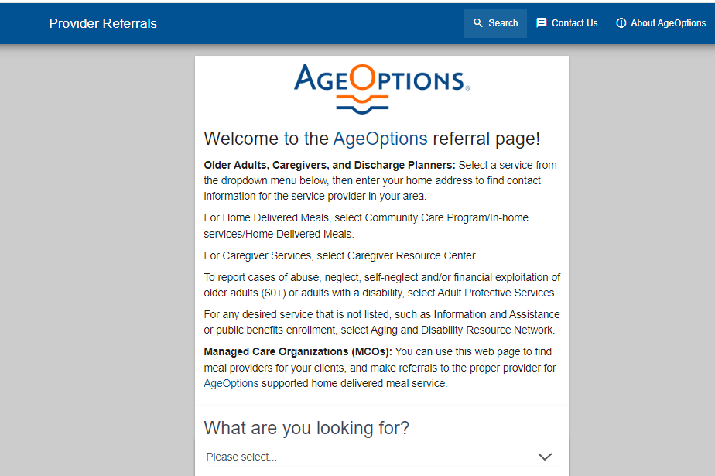
AgeOptions Referral Page
services.ageoptions.org
Notes:
So, if I need information and want to connect my patrons with local older adult services information, how do I go about doing this?
How to find information easily for your patrons – this will be included in the Welcome Packet

Slide 32

FY25 Library CARES Administrative Details
Notes:
Okay – let’s switch gears to all things administrative

Slide 33
FY25 Administrative Details
FY25 Reporting Form as of September 30, 2024
Please use only the most recent version (As of 09.30.2024)
Can be found on the updated Partner Webpage/my emails
Unique Participants and units as hours
Please submit as soon as possible (once you are done for the quarter)
FY25 Stipend Spend Down
Must be spent or committed by September 30, 2025
Please submit
Success Stories
Photo Submissions
Aging Network Display Area Photos
Notes:
Please use the most updated version of the reporting form dated 09.30.2024; continue sharing the success stories and photos

Slide 34

FY25 Quarterly Mandatory Meeting Dates
Meetings are held virtually
Tuesdays from 10:00 am – 11:30 am
    Tuesday, December 10th, 2024
    Tuesday, March 18th, 2025
    Tuesday, June 17th, 2025
    Tuesday, September 16th, 2025
Notes:
There is also a place on the library Partner Webpage where there is an UPDATED calendar with quarterly reminders – due dates, meetings, and other reminders.

Slide 35
FY25 Quarterly Report Due Dates
  Quarterly Reports are due the Friday of the week following quarter-end by close of business:
    Friday, January 3rd, 2025
    Friday, April 4th, 2025
    Monday, July 7th, 2025
    Friday, October 3rd, 2025
Notes:
I will be giving plenty of reminders when quarterly reports are due. There is also a place on the library Partner Webpage where there is an UPDATED calendar with quarterly reminders – due dates, meetings, and other reminders.

Slide 36

FY 2025
There will be a Library Programs Evaluation survey like last year. Stay tuned there will be more at the December meeting
Notes:
This is our new reporting form for the FY24 (October 1, 2023 – September 30, 2024)

Slide 37

FY 2025
Reporting Form
Notes:
This is our new reporting form for the FY25 (October 1, 2024 – September 30, 2025)

Slide 38
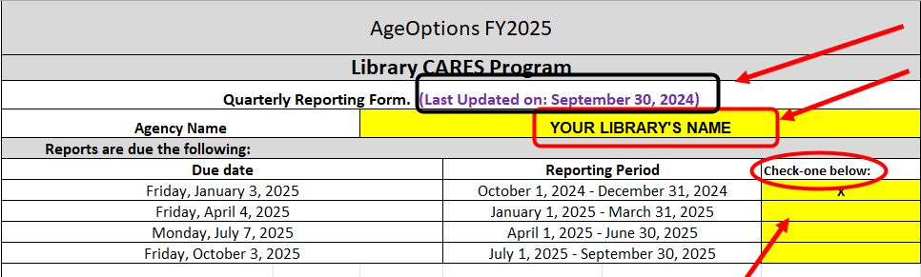
FY 2025 Reporting Form
Notes:
This form has an update as of date of SEPTEMBER 30, 2024. If there are any new updates to the form, I will let you all know via email, the webpage, etc.

Slide 39
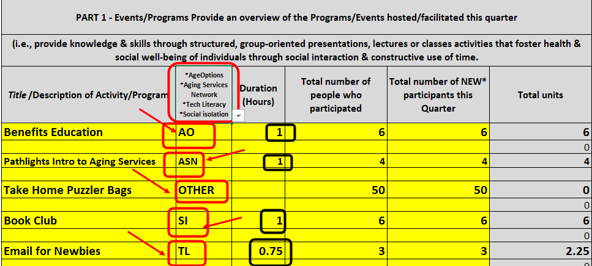
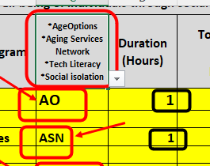
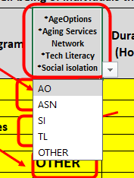
FY 2025 Reporting Form
COLUMN TWO CATEGORIES:
AgeOptions=AO
Aging Services Network=ASN
Tech Literacy=TL
Social isolation-SI
Other=anything else!
Notes:
PART ONE: this is how you tell me you are completing the requirements
DROP DOWN is new!!!! This is how we BOTH keep track of when you meet the grant requirements
DURATION IN quarter hour segments – just the number and NO words
New/unique participant hasn’t changed. Since we are starting a NEW FISCAL YEAR, everyone who attends the FIRST program of the quarter is considered NEW. I will cover New/Unique participants at our December meeting

Slide 40
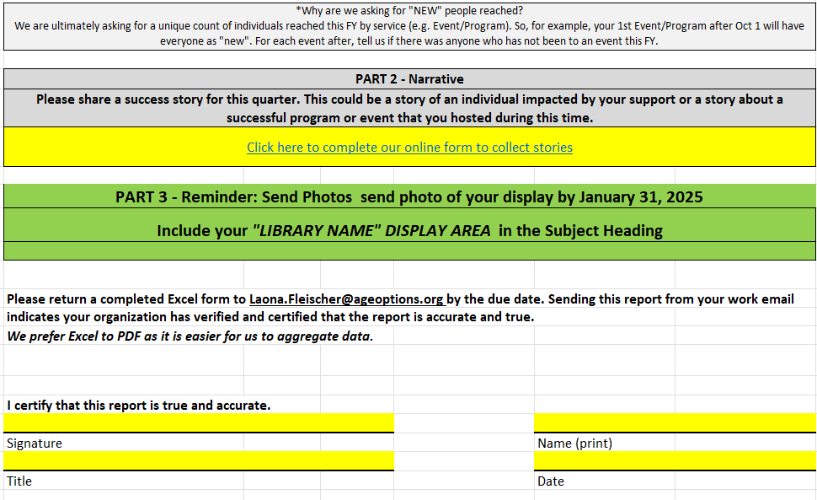
FY 2025 Reporting Form
Notes:
Please submit your quarterly success stories and don’t forget the photos!
This is new: Part 3 is a reminder to complete BEFORE JANUARY 31, 2025
FINALLY – EXCEL!!!! No Pdfs please! You no longer need to include a signature – your submittal of the report via your work email indicates your library has certified and verified the report is accurate and true.

Slide 41
FY25 Quarterly Reporting
Helpful Tips:
Merge “like” programs (Chair Yoga for the month)
Record the length of the program in hours or quarter hours
Capture those new (unique) participants
Funds are to be used for older adults 60+
Notes:
.25, .75, 1.00 Not in minutes! No text – just numerical values

Slide 42





Library Partner Program Share and Tell
You!
Your Public Library!
Notes:
Time to tout programs funded by AgeOptions grant dollars that you want to share with other partners. Remember, if your program has been successful, don’t make your fellow librarians recreate the wheel

Slide 43



FY25 Library CARES Welcome Packet
Notes:
Look out for this packet in the mail! Materials for the librarian AND materials for the patrons
Welcome Letter from Laona
FOR THE LIBRARIAN/STAFF:
Aging Care agency information (and definitions) for your library’s area of coverage (including congregate meal sites, etc.)
AgeOptions 1-pager
AgeOptions “PRESENTATIONS” Descriptions information
How to Navigate the AgeOptions website Instructions
FOR YOUR AGING NETWORK DISPLAY AREA:
“We are” AO, Trualta, and TWP postcards and other EVERGREEN materials for your AGING NETWORK DISPLAY AREA

Slide 44
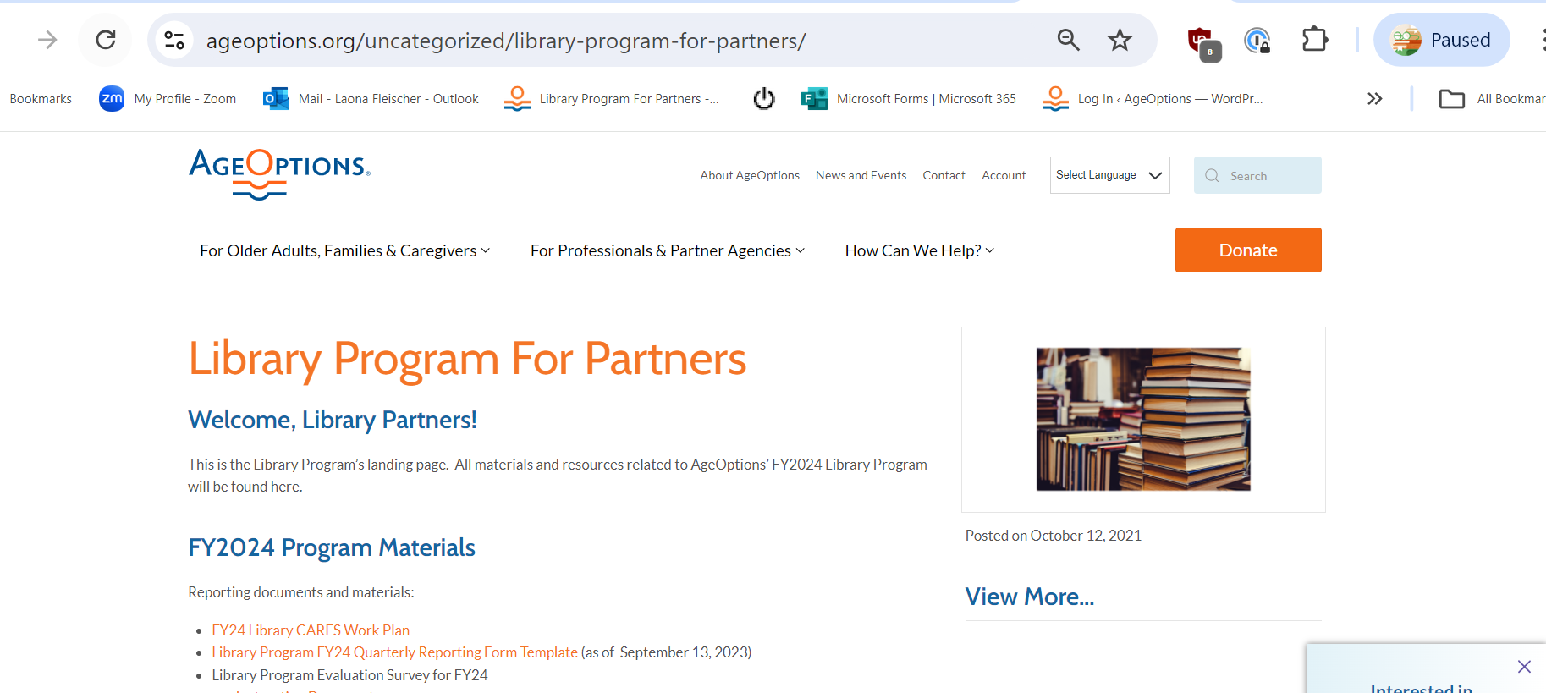
How to find the Partner Page
Library Partner Page
Notes:
BOOKMARK THIS PAGE!!!!!
It will come in handy for forms, dates, resources, etc.
Please give me a few weeks to bring the page up to date for FY25.

Slide 45

Library CARES Q&A
Notes:
ARE WE HITTING ALL WE NEED TO?
Ask questions in chat, by email, or call me!

Slide 46

Group Discussion!
Collaborative program opportunities
Any additional feedback/input?
What has worked well?
Any advice?
Questions about anything!

Slide 47

Many thanks for your participation in the Library CARES grant program and for the work you do to reach out to the older adults in your community.
I’m here for anything related to the library program – please reach out!
708.383.0258 (main number)
708.322.1370 (direct number)
Laona.Fleischer@AgeOptions.org

Slide 48

Services Provided:
AgeOptions provides an umbrella of services for older adults
AGING and DISABILITY RESOURCE NETWORK
CAREGIVER RESOURCE CENTER
NUTRITION
(MEAL PROGRAMS)
Notes:
REACH OUT TO Your ADRN, CRC, AND/OR NUTRITION Services TO HELP YOU MEET GRANT REQUIREMENTS
Aging Network: includes AgeOptions and the social service agencies in suburban Cook County. The Aging Network includes your local ADRN (Aging and Disability Resource Network) agency, Caregiver Resource Center (CRC), congregate meal site and more. I’ll show you how to search for these services in a few slides.
YOU ARE PART OF THE NETWORK! YOU DON’T NEED TO BE THE EXPERT – GET IN TOUCH WITH THESE PARTNERS

