Slide 1
Illinois Dual Eligible Special Needs Plans
(D-SNPs)

Slide 2

What is a D-SNP?
A D-SNP is a special type of Medicare Advantage Plan option for people who are enrolled in Medicare and Medicaid.
Some people may also call these plans FIDE SNPS (pron. “fidey-snip”). In Illinois, FIDE SNPs and D-SNPs are the same thing.
D-SNPs have no premiums but may have co-pays for prescriptions.

Slide 3

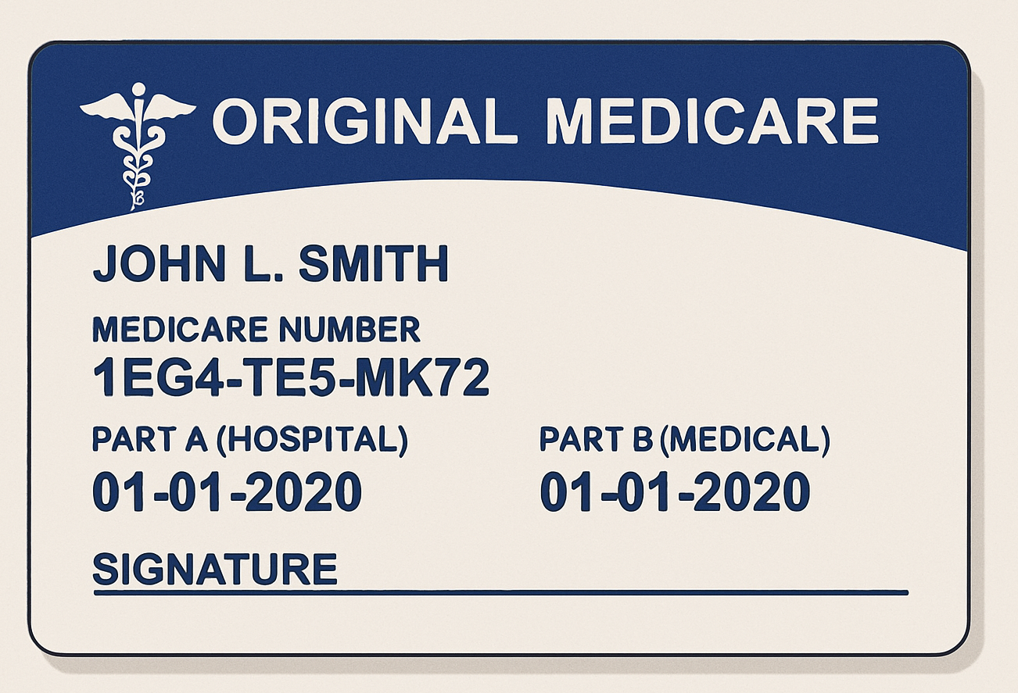
Medicare and Medicaid without a D-SNP
These are the different plans you may have if you have Medicare and Medicaid and you don’t have a D-SNP plan.
Original Medicare for doctor and hospital visits
Part D plan for drugs or a regular Medicare Advantage Plan
Fee-For-Service (FFS) Medicaid (for services Medicare doesn’t cover).
Managed Long Term Services and Supports (MLTSS) plan for long term care (including a caretaker)

Slide 4

D-SNP Plan Members Only Need One Health Insurance Card
D-SNP plans consolidate all Medicare and Medicaid benefits all into one plan
The four Illinois D-SNPs are:
  Molina Medicare Complete Care Plus
  Humana Dual Fully Integrated
  Wellcare Meridian Dual Align
  Aetna Medicare FIDE

Slide 5

Who can get an Illinois D-SNP?
People enrolled in Medicare Parts A and B and full Medicaid
Must be over 21 years old
Cannot have health insurance through a job or the marketplace
You cannot have a D-SNP if you are on a Medicaid Spenddown
Notes:
Notes for presenter:
Age 21 or older
Have Medicare Part A and Part B and eligible to enroll in Part D
Enrolled in full AABD Medicaid (not Spenddown) or in FamilyCare
NOT enrolled in:
Illinois Medicaid Breast and Cervical Cancer program
A partial benefit program (e.g., Medicare Savings Program, Family Planning Program)
Comprehensive third-party insurance
NOT receiving developmental disability institutional services or HCBS waiver for Adults with Developmental Disabilities

Slide 6

What Services Do D-SNP Plans Offer?
D-SNP plans will cover all Medicare and Medicaid services, including:
  Hospital, doctor and therapy visits
  Prescription drugs
  Mental health services
  Skilled Nursing Facilities and Home Health
  Dental, vision and hearing
  Nursing home care, or a caretaker in the home, or any other long-term care or Home and Community Based Service
Also, you will get help from a Care Coordinator to find doctors or other medical services

Slide 7

Can I See Any Doctor?
Your new D-SNP plan will have provider networks.
Except for emergencies, you must visit a provider that is in the plan’s network for it to be covered.
When you enroll in a D-SNP plan for the first time, you have at least 90 days to continue visiting your current providers, even if they do not accept your D-SNP plan

Slide 8

How Do I Pick or Change My D-SNP Plan?
Compare and pick a D-SNP through the Medicare.gov Planfinder or 1-800-Medicare
  If you know exactly what plan you want, you can call the plan directly to enroll
Pick a plan between 10/15/2025-12/31/2025 to start January 1, 2026.
At any time of the year:
  You can enroll in or change to a new D-SNP
  You can leave D-SNPs and return to Original Medicare

Slide 9

What if I don’t want a D-SNP Plan?
You can opt out of a D-SNP plan at any time of the year by contacting Medicare.
If you opt out, you will need to start using multiple insurance cards, because your Medicare and Medicaid will no longer be wrapped into one plan.
You may need to enroll in a drug plan and a plan for long term care services if you use them.

Slide 10

What happens if I lose my Medicaid coverage?
You can keep getting Medicare benefits through your D-SNP plan for at least three months after your Medicaid ends.
When your D-SNP plan ends you have three months to enroll in a regular Medicare Advantage or Part D drug plan through a Special Enrollment Period.
Notes:
Put in a speaker note about the Extra Help/LIS SEP

Slide 11

Need Help? Contact a SHIP Counselor!
The Illinois Senior Health Insurance Program (SHIP) offers free unbiased Medicare counseling. A SHIP Counselor can:
  Help you compare D-SNP plans
  Help you enroll in a D-SNP
  Help you disenroll from a D-SNP
  Answer questions about Medicare
Contact SHIP at (800) 252-8966 to get connected to a counselor near you

