Slide 1
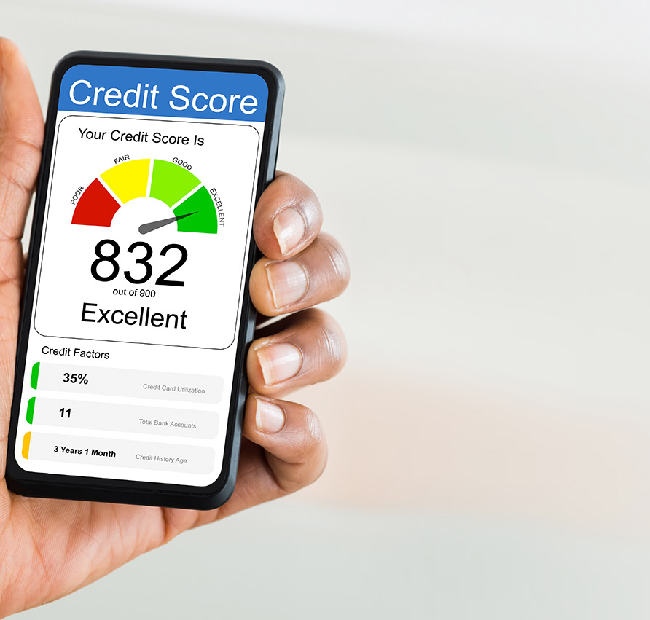
Introduction to Credit Reporting and Credit Scores
Credit Abuse Resistance Education (CARE) Presentation

Slide 2
Let’s Review: What is Credit?
Credit is the ability to borrow money
Borrowing money creates debt
Debt is what you owe
It costs money to borrow money
Notes:
The basic understanding of what is credit and how debt is created are foundational to learning about how credit reports are created and used
Credit scores are built on the information contained in the credit reports
Therefore, this sequential knowledge base is essential.

Slide 3
Your Credit History Affects Whether You Can Buy Things, and How Much They’ll Cost You
Credit history begins when you choose and use credit services
Credit cards
Car loans / leases
Student loans
Mortgages
Insurance
Rent leases
Employment
Notes:
Other types of loans include Personal Loans, Private Label or Retailer Credit Cards, Home Equity Loans, and an emerging category of Point-of-Sale or “Buy-Now-Pay-Later” loans, which are currently not reported to the bureaus
There are two major types of loan categories: unsecured and secured (with collateral, such as real estate property, auto, or cash deposits)
Further, type of loans can be differentiated by open-ended or revolving accounts, and closed-ended or installment loans

Slide 4
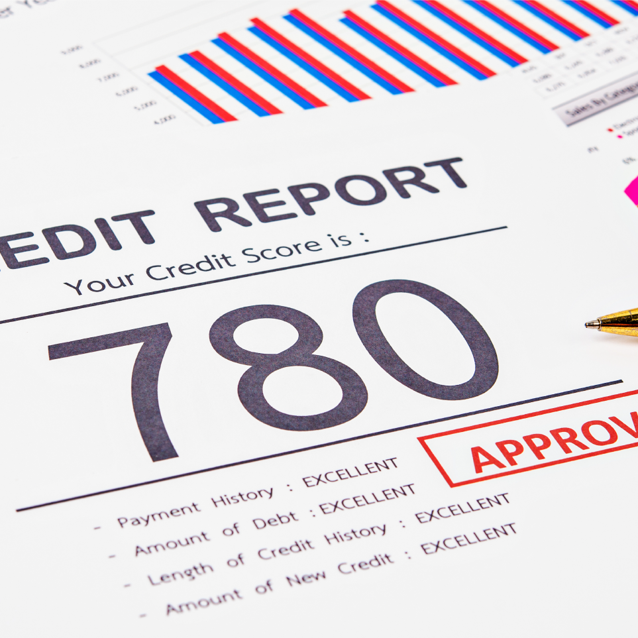
What is a Credit Report?
YOUR ADULT REPORT CARD!
It is prepared by credit reporting agencies for use by stores, banks, landlords, and other businesses that give credit
Tells lenders how much credit you have used and whether you are seeking more credit
It lists the type of credit you use, the length of time your accounts have been open, and whether you have paid your bills on time
Summary of your financial reliability
Notes:
Consider or credit report your adult report card, where instead of subjects studied, the credit report reflects your history of credit seeking, usage, type of credit, length of time credit established, and most importantly, payment information on the obligations
In sum, it is a report card on your financial reliability

Slide 5








Start by Pulling Your Credit Reports
You can get one free report from each of the three national credit reporting companies once a week
Visit AnnualCreditReport.com to download
You can also get free reports or scores from sources such as:
c
Notes:
The first step in rebuilding credit is to obtain your credit reports from the three major bureaus: Experian, Equifax, and TransUnion. These reports provide a detailed view of your credit history, including accounts, payment records, and any negative items. You can request your free credit reports at AnnualCreditReport.com, the only federally authorized source for free credit reports. Reviewing these reports helps identify inaccuracies or outdated information that may be negatively impacting your score. Understanding your current credit status is essential for developing a targeted strategy to improve it.​

Slide 6
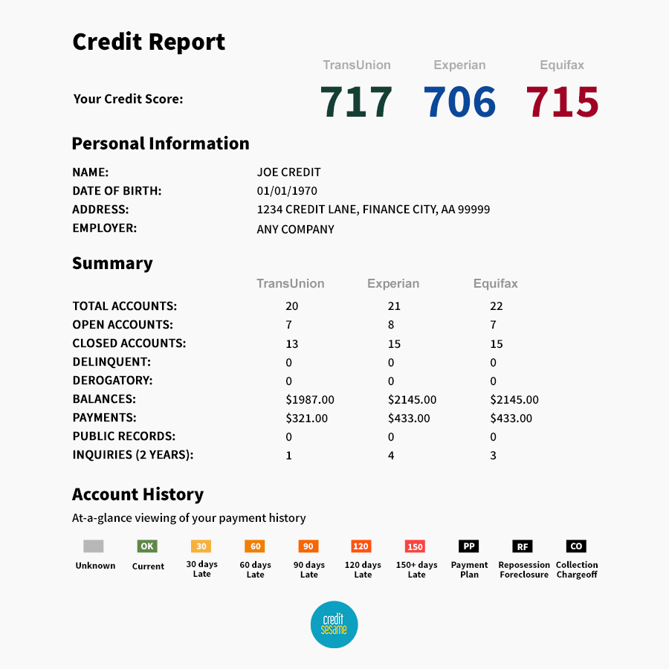
Sample Credit Report
Add a common question that your audience might ask | Write an answer to the question your audience may ask. Make it clear and concise so the audience can quickly skim the content on your slide
Add a common quesion that your audience might ask | Write an answer to the question your audience may ask. Make it clear and concise so the audience can quickly skim the content on your slide
Add a common question that your audience might ask | Write an answer to the question your audience may ask. Make it clear and concise so the audience can quickly skim the content on your slide
Add a common question that your audience might ask | Write an answer to the question your audience may ask. Make it clear and concise so the audience can quickly skim the content on your slide
Add a common question that your audience might ask | Write an answer to the question your audience may ask. Make it clear and concise so the audience can quickly skim the content on your slide

Slide 7
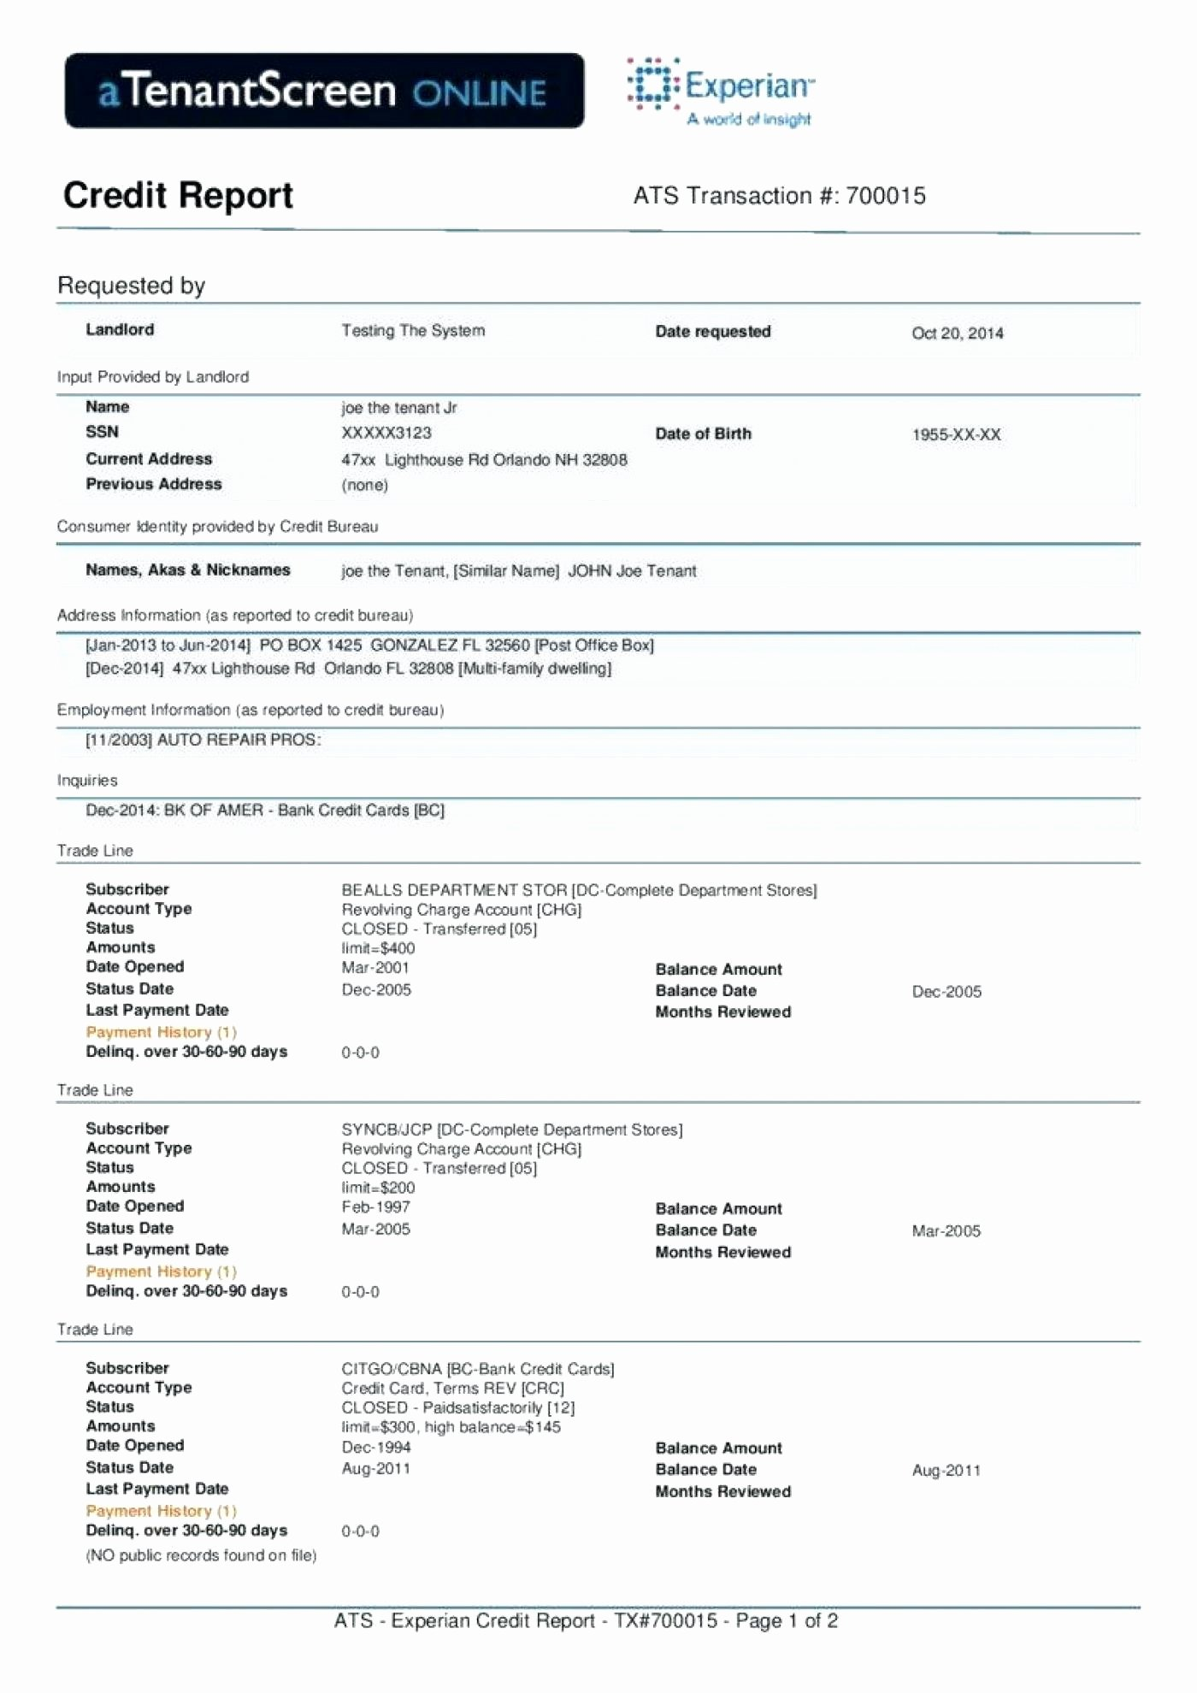
Sample Credit Report
Add a common question that your audience might ask | Write an answer to the question your audience may ask. Make it clear and concise so the audience can quickly skim the content on your slide
Add a common question that your audience might ask | Write an answer to the question your audience may ask. Make it clear and concise so the audience can quickly skim the content on your slide
Add a common question that your audience might ask | Write an answer to the question your audience may ask. Make it clear and concise so the audience can quickly skim the content on your slide
Add a common question that your audience might ask | Write an answer to the question your audience may ask. Make it clear and concise so the audience can quickly skim the content on your slide
Add a common question that your audience might ask | Write an answer to the question your audience may ask. Make it clear and concise so the audience can quickly skim the content on your slide

Slide 8

What is a Credit Score?
YOUR ADULT G.P.A.!
A number calculated by a credit reporting agency that is used by stores, banks, and other businesses as an indicator of how likely you are to repay your debts
Each company that gives credit has its own strategy for using credit scores, and there are many different scores
A Snapshot of your current financial situation
If a company denies credit, it must disclose the reasons
Generated by a mathematical formula
Notes:
Credit reporting agencies: Equifax, Experian, and TransUnion
Credit score models: FICO, Vantage, etc.

Slide 9
What’s in a Credit Score?
These ARE in a credit score:
Payment history
Outstanding debt (balances)
Credit account history and usage
Recent “hard” inquiries*
Types of credit used
These are NOT:
Demographic information Age, race, religion, national origin, gender, sexual orientation, marital status, residence, child / family support obligations
Employment information Salary, occupation, title
Other credit information Interest rates, “soft” inquiries*, usage of a credit counseling company
* “Hard” inquiries are typically applications for credit and they ARE used in a score; “soft” inquiries are usually for marketing prescreening and are NOT used in credit scoring

Slide 10
What’s in a Credit Score? Paying on-time and keeping balances low are most important!
Payment history
Account payment information
Bad public records
Amount of past due accounts
Number of past due items
New Credit
Number of recently opened accounts
Number of recent inquiries
Types of credit used
Number of various types of accounts
Credit history length
Time since accounts opened
Amount owed
Outstanding balances on accounts
Proportions of balances to total credit limits
Proportion of installment loan amounts
Notes:
There are many credit scores in the marketplace, including those developed by vendors such as: FICO, VantageScore, Equifax, Experian, and TransUnion
Most lenders develop their own proprietary scores
Therefore, the pie-chart here is a directional illustration of the relative importance of each credit bureau data element.

Slide 11
What’s a Good Credit Score?
Depends on the score; typically, the higher the score the better
Each company decides what it thinks a good score is
For example, your credit score might be 690
Based on one system, here is how you may be viewed by a company that gives credit
300
400
500
600
700
800
900
You are here
Very
poor
Poor
Fair
Good
Very Good
You are here
Notes:
If the lender’s underwriting criteria set the approval cut-off at a score of 650, for example, then in this illustration, the applicant with a score of 690 would get approved. However, because the applicant’s score was barely “passing”, the terms of the loan (i.e., cost) may be higher, to compensate for the lender’s assumed greater risk of future default.

Slide 12
Top 5 Misconceptions About Credit Scores
1
2
3
4
5
Your credit score will drop if you check your credit report
Closing old accounts will improve your credit score
Once you pay off a bad record, it is removed from your credit report
Being a co-signer doesn’t make you responsible for the account
Paying off a debt will add 50 points to your credit score
Notes:
Demand Deposit Accounts (checking / saving) are not reported to the CRC’s; therefore, not included in traditional credit scores

Slide 13

Understanding Credit Damage
How does credit get impaired?
Late or missed payments
High utilization or excessive borrowing
Collections / Charge-offs / Foreclosure / Bankruptcy
Impaired, or bad, credit stops you from getting access to loans when you need them, and / or the loans are very costly
Notes:
Let’s start by understanding what impaired credit means. It’s more than just a low score – it’s when your credit history includes serious issues that affect your financial life. Impaired credit can result from a variety of financial missteps and life events. Common causes include missed or late payments, high credit utilization, bankruptcy, foreclosure, and defaulting on loans. Financial hardship, such as job loss or medical emergencies, often leads to difficulty in meeting financial obligations. Additionally, a lack of budgeting and financial planning can exacerbate these issues. For instance, relying heavily on credit cards without a repayment strategy can quickly spiral into unmanageable debt.
This is also a good time to call out that the medical emergencies could cause financial hardship to pay other bills but Illinois law makes it unlawful for consumer reporting agencies to:
Include medical debt or related collection actions in any credit report or Maintain files containing medical debt information. It’s important to note that this law varies by state.

Slide 14

Pay Bills On Time – Every Time
The single most important part of your credit score is whether you make payments on time
Benefits of Timely Payments​: Consistently paying bills on time builds financial trust and improves credit scores over time
Use of Reminders and Automation: Setting reminders or automatic payments helps avoid missed due dates and late fees​
Risks of Late Payments: Even one late payment can negatively impact credit scores and financial opportunities significantly​
Notes:
Payment history accounts for 35% of your FICO credit score (for example), making it the most influential factor. Consistently paying bills on time demonstrates financial responsibility and builds trust with lenders. Setting up reminders or automating payments can help avoid missed due dates. Even one late payment can have a significant negative impact, so it's crucial to prioritize timely payments. Over time, a strong payment history will contribute to a higher credit score and better financial opportunities.​

Slide 15

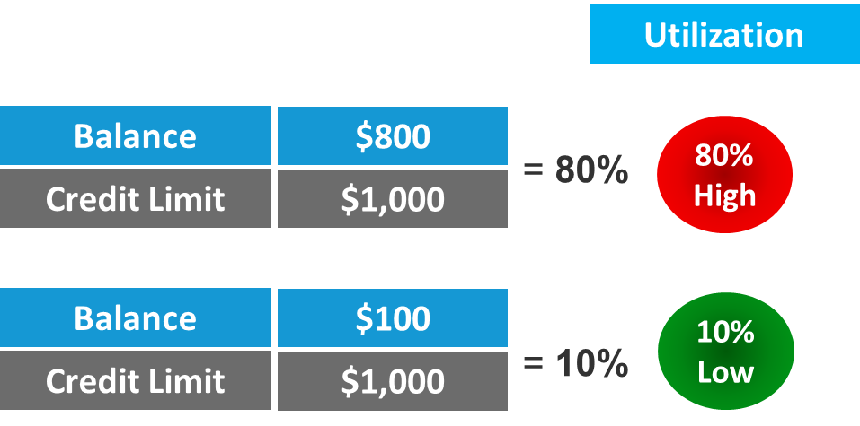
Reduce Credit Utilization
Credit Utilization​ is the percentage of available credit currently being used​
Strive for below 30%, ideally under 10% -- helps improve credit scores effectively​
High credit utilization signals financial stress and can negatively affect credit scores​
Managing Utilization effectively by paying down balances and avoiding new charges to maintain a healthy credit utilization ratio
Avoid closing paid-off credit card accounts, which artificially increases “total utilization”
Notes:
Credit utilization refers to the percentage of your available credit that you're using. Keeping this ratio below 30%—and ideally under 10%—can positively impact your credit score. High utilization suggests financial stress and may lower your score. Paying down credit card balances and avoiding new charges helps maintain a healthy utilization rate. This step is especially important for individuals with limited credit lines, as even small balances can significantly affect their utilization ratio.​
Also, be mindful about closing older credit card accounts, which may decrease your credit score. When you close an older account, two elements important to a credit score disappear: 1) the age associated with that account – a longer history has a positive impact to your score, especially if you’ve had many months of “paid-as-agreed”, and 2) the credit limit associated with the closed account is no longer calculated in your “total credit utilization” – your overall denominator (total balances divided by total credit limits) is reduced, thereby artificially inflating the overall utilization rate, which negatively impacts the score. Instead, periodically activate that account once or twice a year by making a small purchase and immediately paying it off at statement cycle or prior. This will keep your account active and in good standing and avoid the issuer either charging you an inactivity fee (which they must disclose to you upfront), or closing the account due to inactivity, which may negatively impact your score.

Slide 16
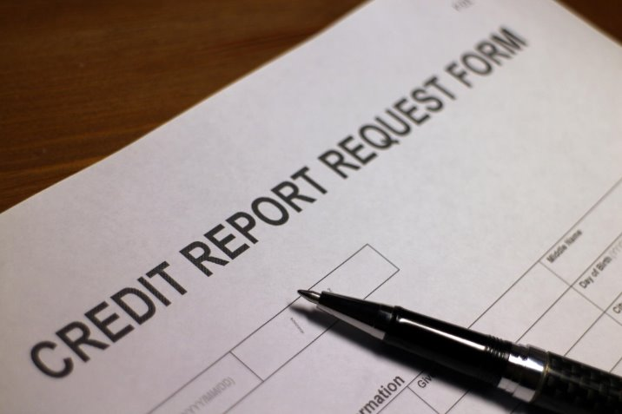
Avoid Hard Inquiries
Hard inquiries occur with each credit application and can lower your credit score significantly​
Limit credit applications because applying for multiple credits in a short time signals financial risk and lowers lender confidence​
Importance during rebuilding​ -- Avoiding hard inquiries is crucial during credit rebuilding when every point in your score matters
Notes:
Each time you apply for credit, a hard inquiry is recorded on your credit report. This is different than a soft inquiry. A soft inquiry isn’t reported on your credit report. Examples of a soft inquiry is when you look at your own report, an insurance company gives you a quote or an employer or landlord reviews your report.
Multiple hard inquiries in a short period can lower your score and signal financial instability to businesses. It's advisable to limit new credit applications and only apply when absolutely necessary. Being strategic about credit inquiries helps preserve your score and demonstrates responsible credit behavior. This is particularly important during the credit rebuilding process, when every point counts.

Slide 17
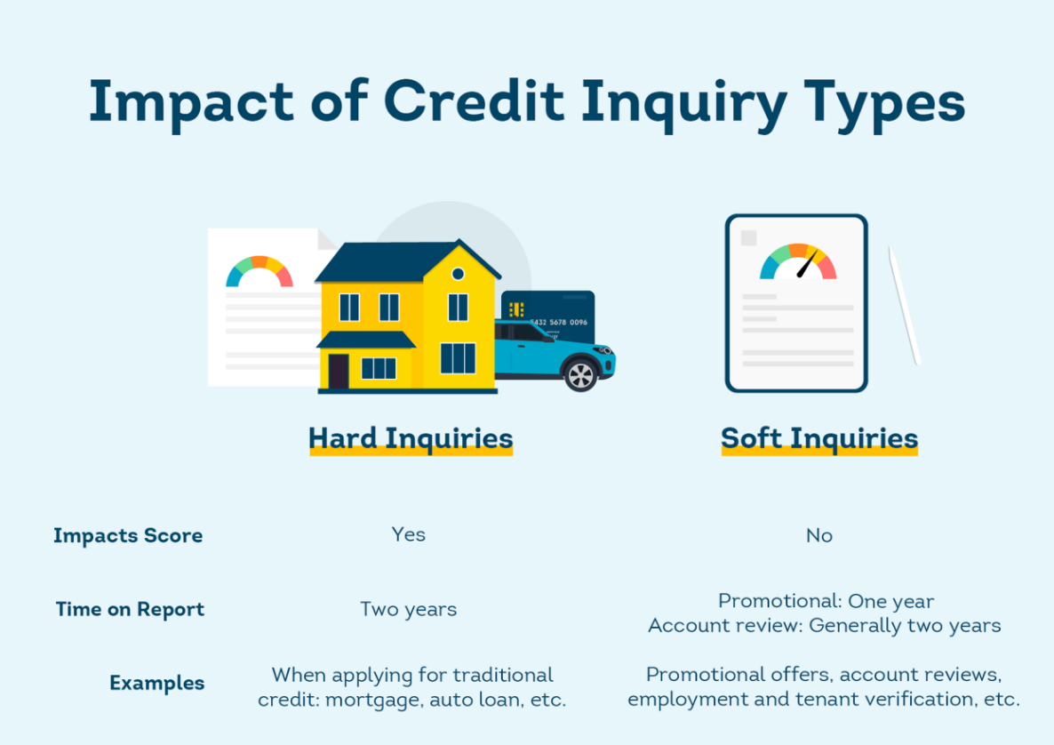
Unlike Hard Inquiries, Soft Inquiries do NOT Impact Your Credit Scores, and There are Two Types of Soft Inquiries
Promotional inquiries:
Credit offers, such as pre-approved credit card
Buy Now, Pay Later Loans may result in a soft inquiry
Account review inquiries:
Insurance underwriting, employment verification, tenant screening
Prequalification for loans such as mortgage
When you, or a lender with whom you have an existing account, periodically checks your credit file
Source: www.transunion.com/blog/credit-advice/what-is-a-soft-inquiry
Notes:
Soft inquiries can appear on your credit report in connection with promotional offers and account reviews. Promotional inquiries stay on your credit report for one year, while account review inquiries can stay on your report for two years. Even if you have a Credit Freeze in place, lenders you currently do business with can still send targeted promotional offers and insurers can still review your credit report for underwriting purposes. Also, landlords and employers can also verify your credit with a credit freeze in place. However, Soft Inquiries do not impact your credit score.
It is important to note, if you have a credit card account in good standing, and it is active, when requesting a Credit Limit Increase, most credit card issuers will treat the request as an Account Review and therefore, post a Soft Inquiry. When all else is equal, this will have a positive effect on your credit score, because your utilization is decreased when your balances do not change or decrease.

Slide 18
More Credit Management Tips…
Set Goals
Clean up your records
Monitor your transactions
Check your credit report at least every three months
Improve your credit score 50 points or to above 650
Reduce your credit balances to below 30% of available credit limit
Create a budget and stick to it
Dispute inaccuracies on your credit report
Remove expired debts and collection accounts
Consider refinancing a credit balance
Guard against identity theft
Notes:
Set up alerts with credit card issuers, such as when balance thresholds are passed or an authorization for a purchase exceeds a certain dollar amount
Be careful with balance transfers when solving for reduced credit card utilization; fees may offset the benefits

Slide 19
If You Find a Mistake…
At the conclusion of the investigation, or within 30 days, you’ll be notified of the outcome
Credit reporting agency will investigate the issue
If this does not work, contact the credit reporting agency reporting the inaccurate information
Next, contact the company responsible for the inaccuracy and try to resolve the issue
First, correctly identify inaccurate information
You have the right to dispute inaccurate information on your credit report

Slide 20

Other Tools and Resources
Budgeting Applications​
Budgeting apps help track income and expenses, enabling better financial planning and debt management​
Credit Counseling Agencies​
Credit counseling agencies offer expert guidance to develop personalized debt management plans. Research to understand:
Are they legitimate, and not a scam
Evaluate consultation fees (most reputable ones are free)
Consider all your debt relief options
Notes:
Various tools and resources are available to assist individuals in rebuilding their credit. Credit monitoring services provide regular updates and alerts about changes in credit reports, helping users stay informed. Budgeting apps enable better financial planning by tracking income and expenses, which is crucial for managing debt and avoiding missed payments. Secured credit cards offer a way to build or rebuild credit by requiring a cash deposit that serves as collateral. Credit counseling agencies provide professional guidance and support, helping individuals develop personalized plans for debt management and credit improvement. These resources can be both free and paid, depending on the provider. Utilizing these tools effectively can accelerate the credit recovery process and foster long-term financial health. For example, a budgeting app can help identify unnecessary expenses, while a credit counselor can negotiate with creditors to create manageable repayment plans. Leveraging these resources empowers individuals to take control of their financial future.​
Before seeking credit counseling, research agencies to verify their legitimacy, evaluate their fees, and understand all of your debt relief options. Reputable, non-profit agencies will offer a free initial consultation to help you develop a personalized plan, which may include a debt management plan.

Slide 21

Beware of Credit Repair Scams When They:
Guarantee results
Demand payment up front
Have you dispute accurate information
Advise you to ignore credit reporting agencies
Don’t explain your rights to you
Ask you to lie
Report suspected scams to the Federal Trade Commission (FTC)
Remember: you can do a lot of what these “agencies” offer yourself, at no cost
Notes:
Many services offered by credit repair companies are available to you directly through the Credit Reporting Agencies for FREE. Not all credit repair companies are bad, but some may be trying to take advantage of you. You can learn more about credit repair organizations and what to do if you’ve been misled by visiting the Federal Trade Commission website: https://consumer.ftc.gov/articles/fixing-your-credit-faqs#Credit%20Repair

Slide 22

Be Patient and Consistent
Progress may be slow, but it’s worth it!
Long-term Credit Rebuilding​
Credit rebuilding is a gradual process requiring 12 to 24 months of consistent financial behavior
Consistency in Best Practices​
Paying bills on time and reducing debt are essential consistent habits for improving credit scores​
Setting Realistic Expectations​
Maintaining realistic goals and commitment supports steady progress toward a stronger credit profile
Notes:
​Rebuilding credit is a long-term process that typically takes 12 to 24 months. Consistency in following best practices—such as paying on time, reducing debt, and avoiding new inquiries—is key to success. It's important to set realistic expectations and remain committed to your financial goals. Over time, these efforts will lead to a stronger credit profile and greater financial opportunities.​

Slide 23
CARE Chicago does not offer personal financial counseling, but you may consider the following resources:
Operation Hope offers free one-on-one financial counseling. https://operationhope.org/
Capital Good Fund is a nonprofit that offers financial coaching for a low fee and low cost loans to help individuals rebuild their credit. https://capitalgoodfund.org/
Center for Changing Lives is a Chicago organization that provides financial and housing coaching. https://www.cclconnect.org/en/financial-housing-coaching
American Consumer Credit Counseling assists with debt repayment plans. https://www.consumercredit.com/
National Foundation of Credit Counseling provides individual counseling and debt repayment plans. https://www.nfcc.org/
The Illinois Financial Wellness Hub, provided by the Illinois Treasurer’s Office, will assess your financial situation and make recommendations for its tools, content and webinars to assist you. They also offer free access to certified financial planners. https://illinoistreasurer.enrich.org
Chicago Urban League’s Housing and Financial Empowerment Center (HFEC) is a HUD-approved housing counseling agency that provides low- to moderate-income residents with professional housing counseling assistance. https://chiul.org/program/housing/
Notes:
Many of these are free services, or for a modest fee.

Slide 24
Rebuilding credit is a marathon, not a sprint. Stay consistent, be patient, and don’t hesitate to ask for help.
Thank You!
www.carechicago.org

